Slide 1
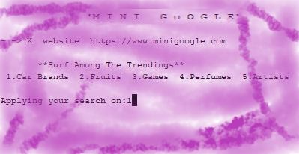
‘MINI GOOGLE’
Presented By:
[Dipesh Shrestha]
[1NH17CS039]
[ 3rd ‘A’ ]

Slide 2
OBJECTIVES:
To provide easy interface for the user to interact with the options available.
To search the element that user want with least possible letters (min 2 letters).
To make the search less time consuming.
To suggest with every possible words that matches the user input.

Slide 3
Data Structures:
File:
File is a non-primitive data structure which is used to store related information. When your program terminates, all the data gets deleted. But storing data into file will preserve your data.
Mini Google uses various files and each stores the data related to specific field.
Linked List:
Linked list is a linear data structure which consists of nodes and each node stores data and address of other node.
Mini Google uses single linked list to filter out the result and display it to the user.

Slide 4
Functionality:
Input operations:
Mini Google first understands the user in which field they want to place their search on by giving them wide range of options.
Accepts minimum of two letters from user as input.
Processing operations:
Mini Google then uses linear search technique to match the user input with all the contents of file.
Passes all those matched results to linked list one by one.
Output operations:
Finally the searched results are displayed to the user with the help of display operation of linked list.

Slide 5
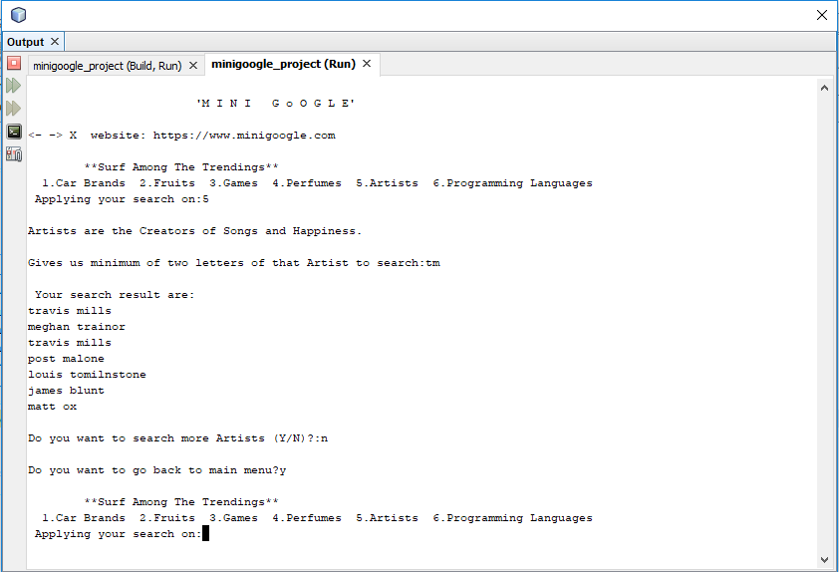
Sample Output:

Slide 6
How objectives achieved in the project?
Using switch-case statement this project is able to display various options.
This project doesn’t want the complete letters of the word which was possible using linear search technique and made the matching process less time consuming.
Using linear search technique this project was able to filter out every possible matching results.
Linked list helped to store all the matched results and display all at a time.

Slide 7
THANK YOU!
-From Mini Google family

